Slide 1

Online Result Publication
SOUTHERN UNIVERSITY BANGLADESH
Faculty of Science & Engineering
Department of Computer Science & Information Technology(CSIT)

Slide 2
Submitted By
Rajib Baran Sarker
ID-006-11-01
&
Mizanur Rahaman
ID-006-11-07

Slide 3
Supervisor
Prof. Ahmad Hossain
Co-Supervisor
Lecturer
Tasnuva Ahamed
Dept. of
Computer Science and Information Technology
Southern University Bangladesh

Slide 4
ABSTRACT
In this project we develop an online result publishing system. This system help the result publishing process easier and efficient rather then manual system. To develop this project we followed unified process that all the phases including analysis, design and implementation and testing performed. This project is a web based application that is developed in PHP having MYSQL as back end.

Slide 5
Objective
To develop an online result publishing system.
Reduce the lagging of Result published.
Easy to handle the huge data at a time.

Slide 6
Introduction
This project is to develop an online result publishing system for student. The objective and purpose of the online result publishing system helps the student to obtain result easily and to overcome the problem of manual system.

Slide 7
Scope
Scope of this project is very broad in terms of other manual system. Few of them are:-
This can be used in Educational Institutions like Schools, Colleges, and Private Institutes
Can be used anywhere any time as it is a web based application

Slide 8
Software And Hardware Requirements
▪ Software Requirements
Client Side: Web Browser – Internet Explorer 6 or above
Web Server: Applications – PHP 5.4, Xamp Server 2.1.7
Data Base Server: MYSQL
▪ Hardware Requirements
Client Side: Processor - Pentium IV 2.0 and above.
Server Side: Processor - Pentium IV 2.0 and above.

Slide 9
Problem of Current System
The current system is complicated to maintain the huge volume of papers.
Its takes time to find out the previous result.
Lack of security.
Result record is not find easy way.

Slide 10
Solution of the Problem
It will be Automation that will help the user to do their work properly.
Task can be performed faster than manual.
Information collection is easier.
Timely and first report generation.
Easy maintain, update database.

Slide 11
System Diagram
Administrator
Result Publishing
Login
Authentication Student
Authentication Instructor
Authorized Instructor
Update Result
Login
Modify Result
Student
View The Result

Slide 12
Relational Schema
Student( St-id, Name, Dept, Season)
Teacher( T-id, Name, Dept, Designation)
Course( C-code,Title, Semester, Credit)
Enroll( C_code, St_id, Semester, Year)
Taken(C-code, T_id , Semester, Year)
Result(C-code,St-id, Semester, Year, Mark,Grade)

Slide 13
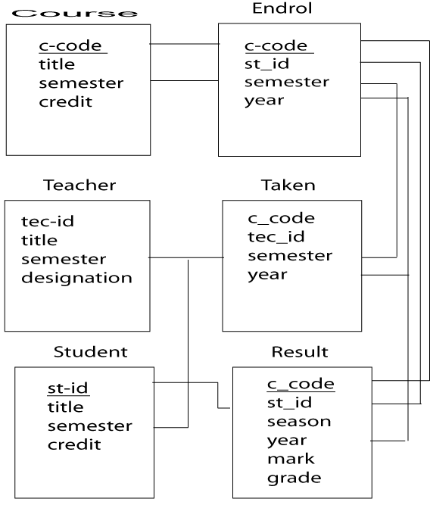
Schema Diagram

Slide 14
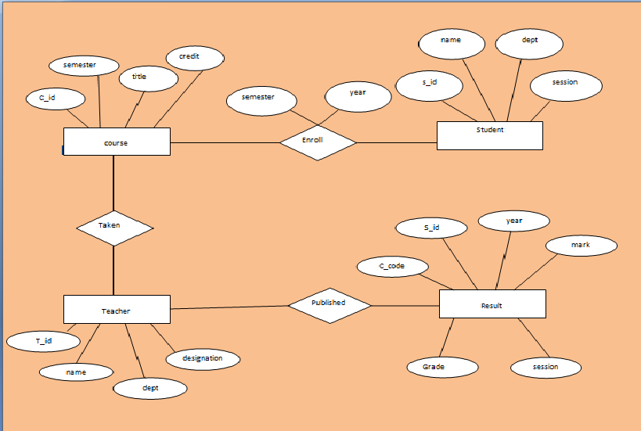
Entity Relationship Diagram

Slide 15
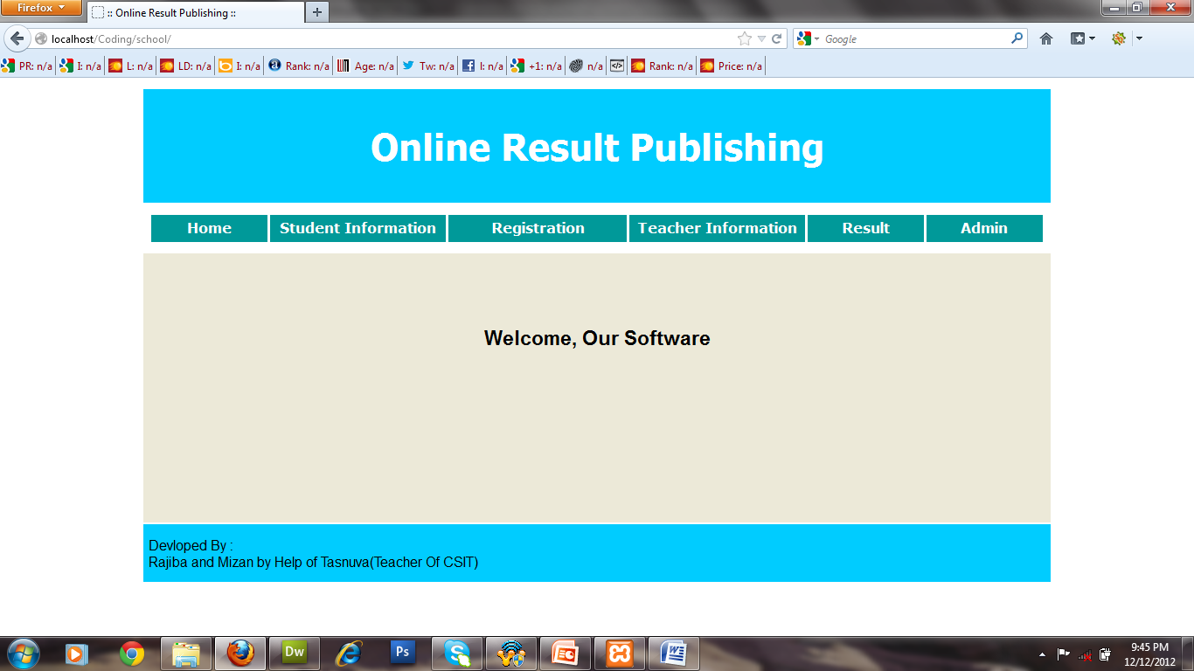
Software Home Interface

Slide 16
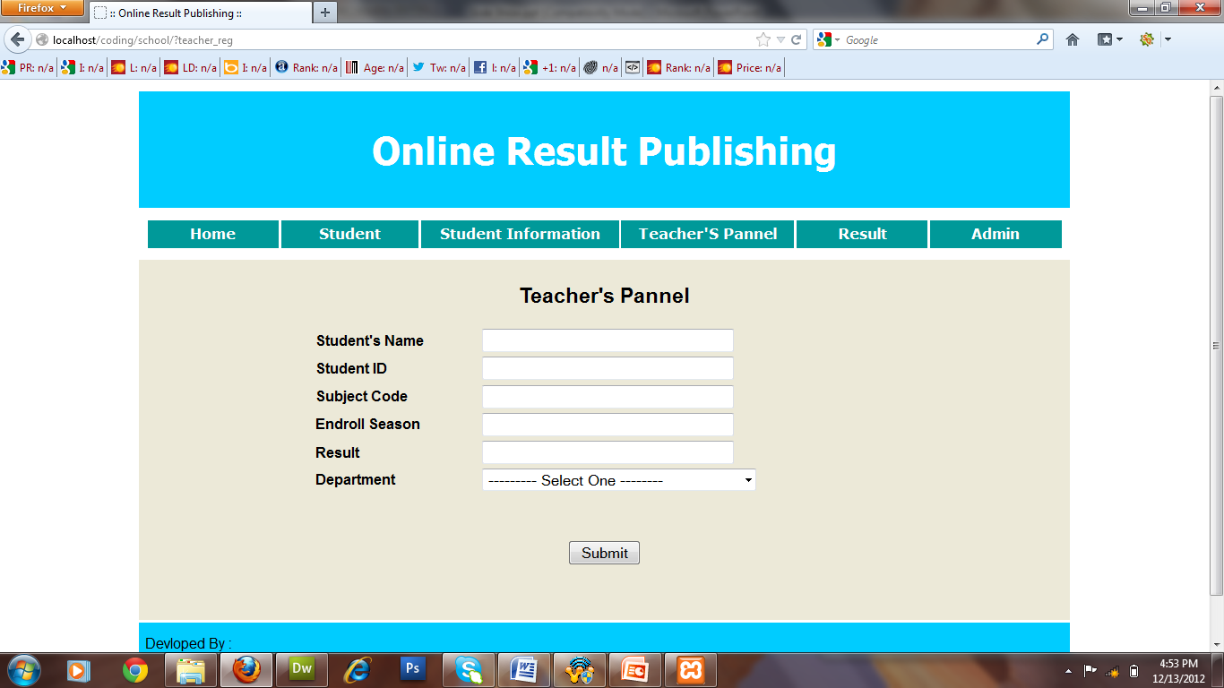

Teacher's Information

Slide 17
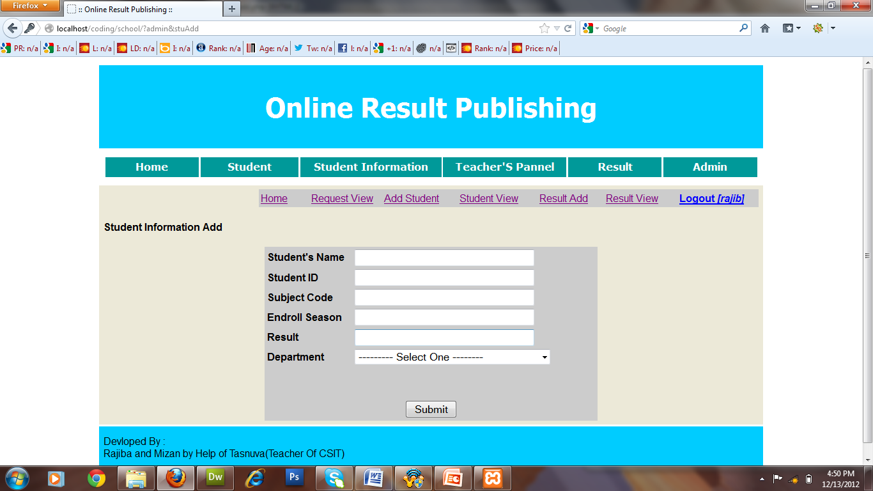
Add Student

Slide 18
Thank To All

